Slide 1







Skills Analysis
Gia Bao Tran
June 14, 2023

Slide 2



OUTLINE
Executive Summary
Introduction
Methodology
Results
Visualization – Charts
Dashboard
Discussion
Findings & Implications
Conclusion
Appendix

Slide 3

EXECUTIVE SUMMARY
Figuring out the required skills for the IT or Data fields.
Identify the future skill requirements and trends to keep peace with the development of technology.
Showing current and future trend in Programming Languages, Databases, Platforms.
Help companies and candidates save time to focus on specific important skills.

Slide 4

INTRODUCTION
The presentation used for stakeholders and business decision makers in IT and Data fields.
The presentation will help the organizations figure out these important technical skills based on trends from several charts.

Slide 5

METHODOLOGY
Clean and organize data by using a modified subset of the Stack Overflow dataset¹.
Next, exploring data to find the distribution of data, outliers and determine the correlation between different values in dataset.
Use data to visualize the relationship between two features.
Finally, use two modified files of the Stack Overflow dataset, Cognos Dashboard Embedded (CDE) to find the trends for the data field.

Slide 6

Appendix
To obtain the number of GitHub job openings the GitHub Jobs API³ was used, and the collected data was stored in an excel spreadsheet⁴.
To obtain average annual salaries web scraping was used to extract information from a website⁵ then saved to a csv file⁶.

Slide 7

RESULTS

Slide 8
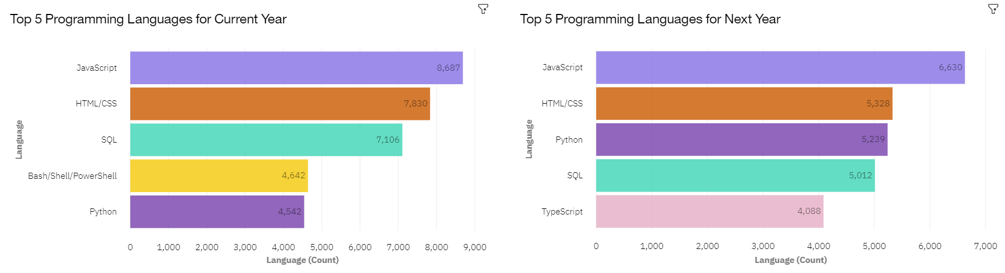
PROGRAMMING LANGUAGE TRENDS
Current Year
Next Year

Slide 9
PROGRAMMING LANGUAGE TRENDS - FINDINGS & IMPLICATIONS
Findings
JavaScript still play the important role in the Data Field
TypeScript and Python have gained interest for next
Whereas recording decrease in SQL, Bash, Shell, and Power Shell.
Implications
Hiring a similar number of candidates using JavaScript and HTML/CSS
Focus on Python and TypeScript.
Employ less in SQL, Bash, Shell, and Power Shell.

Slide 10
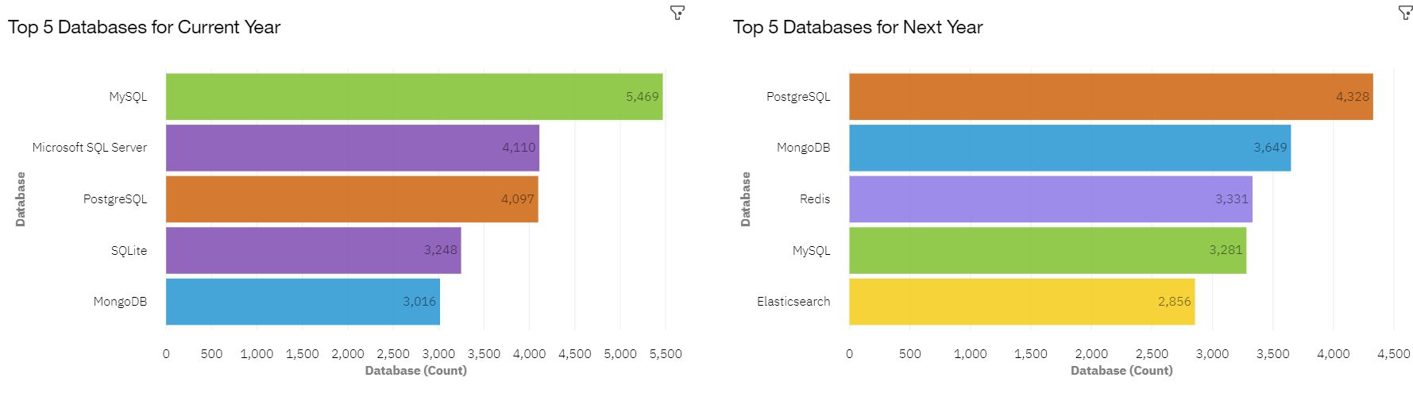
DATABASE TRENDS
Current Year
Next Year

Slide 11
DATABASE TRENDS - FINDINGS & IMPLICATIONS
Findings
Interest in MySQL, Microsoft SQL Server and SQLite has decreased for next year.
Interest in PostgreSQL and MongoDB have increased compared to the current year.
There is gained interest in Redis and Elasticsearch for next year..
Implications
Employ less people skilled in MySQL, Microsoft SQL Server and SQLite.
Employ more people skilled in PostgreSQL and MongoDB.
Employ more people skilled in Redis and Elasticsearch.

Slide 12

DASHBOARD
Click here to view the
Cognos dashboard

Slide 13
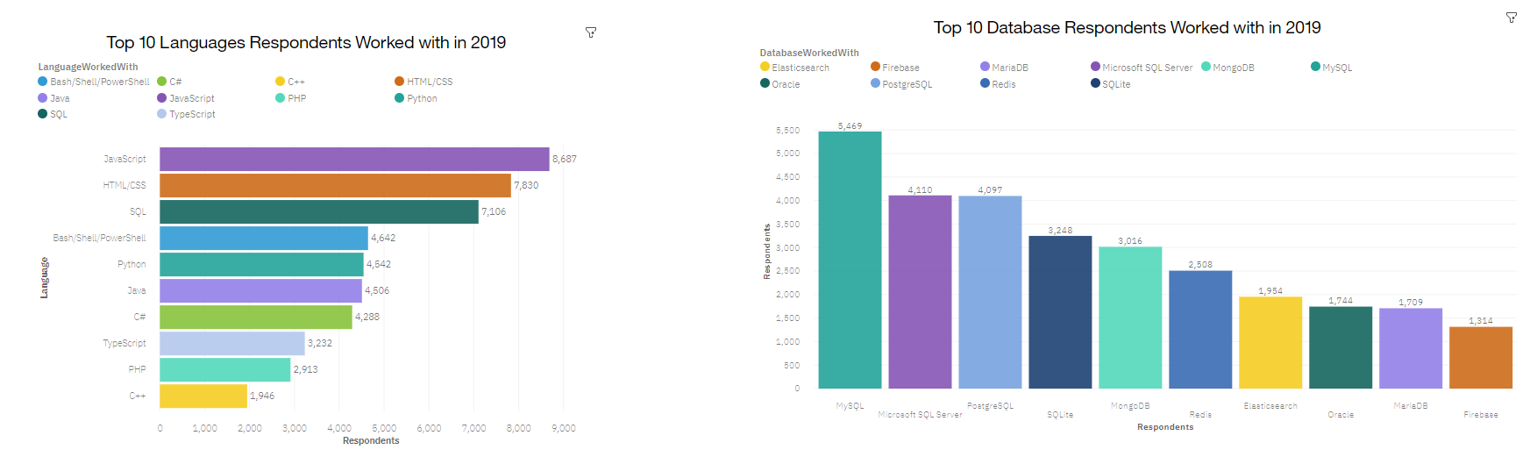
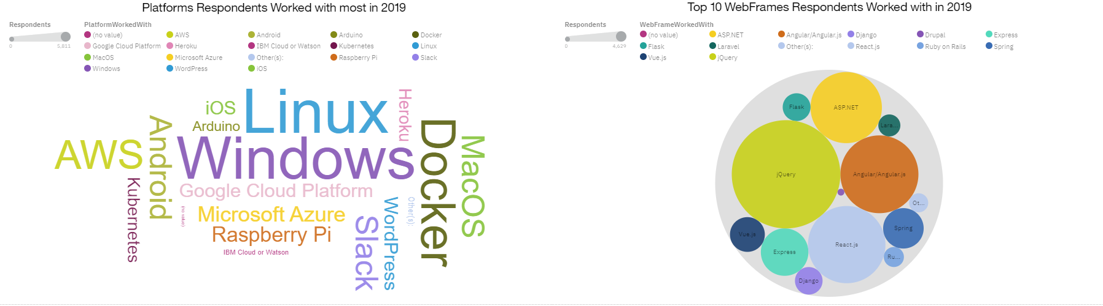
Current Technology usage

Slide 14
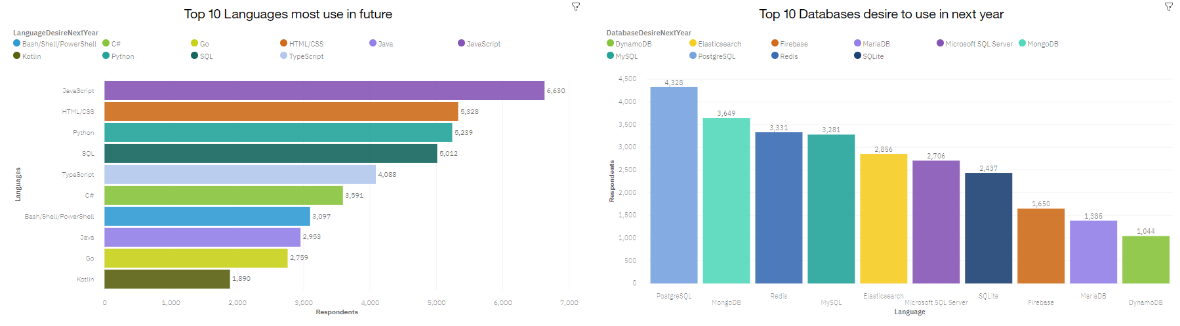
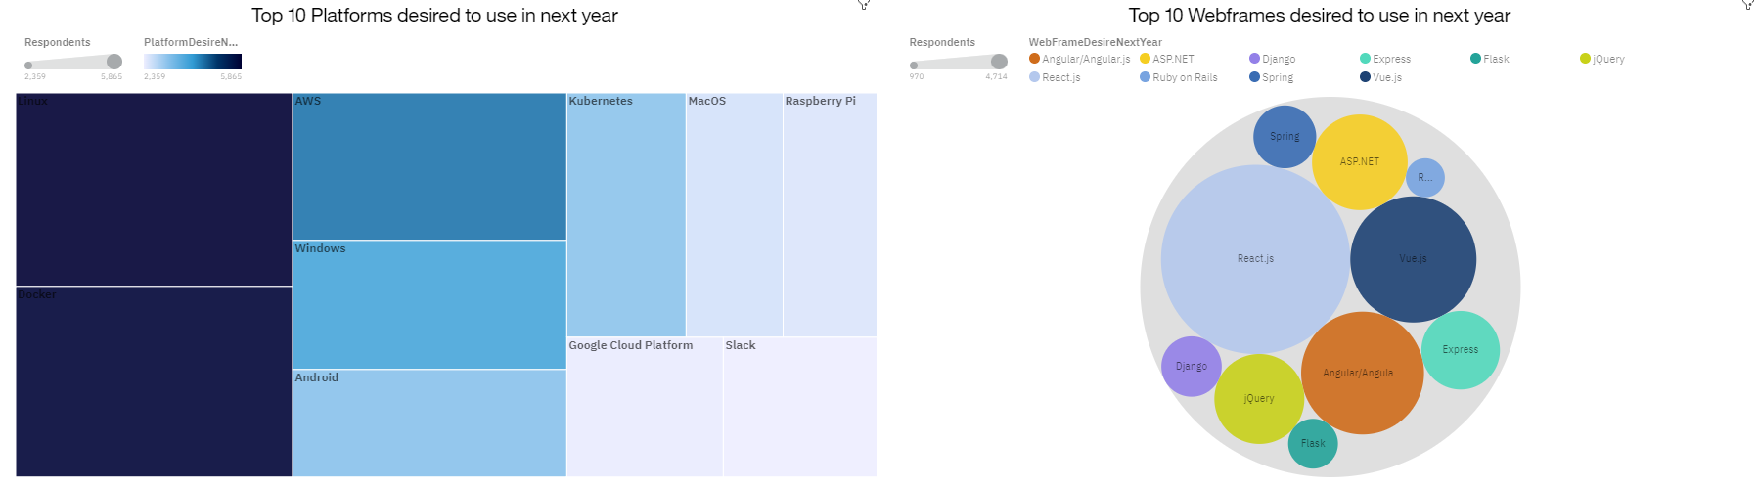
FUTURE TECHNOLOGY TRENDS

Slide 15
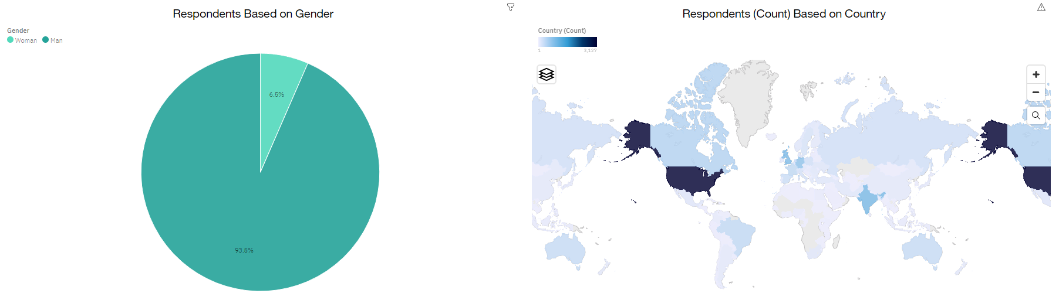
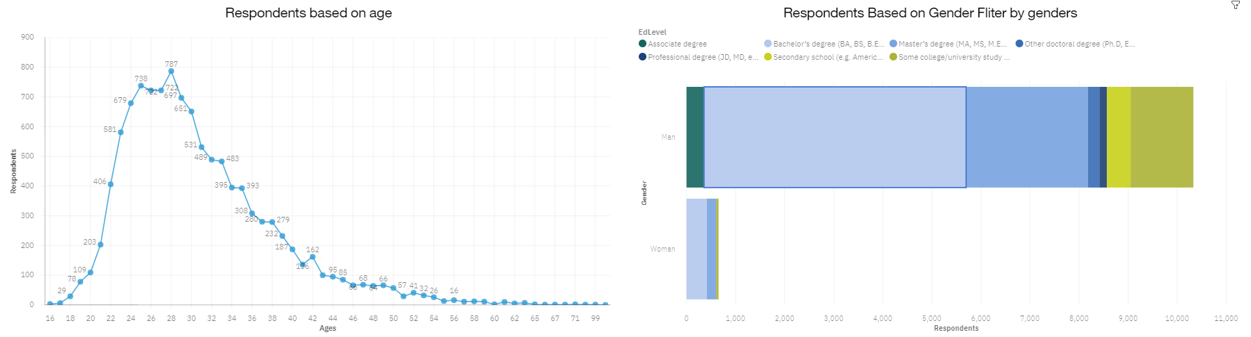
DASHBOARD TAB 3
DEMOGRAPHICS

Slide 16
DISCUSSION

Slide 17
OVERALL FINDINGS & IMPLICATIONS
Findings
Programming Languages - TypeScript is gaining significant interest and Python continues to grow as well.
Databases - Redis, Elasticsearch, PostgreSQL and MongoDB are gaining more interest.
Platforms - Interest Slack is dropping significantly.
WebFrames - Vue.js is gaining substantial interest and React.js continues to grow as well.
Implications
Continue to staff enough JavaScript and HTML/CSS but employ more people skilled in TypeScript and Python.
Employ more people skilled in Redis, Elasticsearch, PostgreSQL and MongoDB.
Continue to staff enough Linux, employ more people skilled in Docker, AWS and Android, but make reductions to Slack and Windows.
Continue to staff enough ASP.NET but employ more people skilled in Vue.js and React.js.

Slide 18

CONCLUSION
Carve out budget in order to hire additional staff with skills needed to fill any gaps.
Set aside budget or put a program in place to upskill those already employed.
Make adjustments in staff for those skills no longer in demand.

Slide 19

APPENDIX

Slide 20
GITHUB JOB POSTINGS BY LANGUAGE

Slide 21
POPULAR LANGUAGES BY AVERAGE ANNUAL SALARY

Slide 22
resources
https://stackoverflow.blog/2019/04/09/the-2019-stack-overflow-developer-survey-results-are-in/
m5_survey_data_demographics.csv and m5_survey_data_technologies_normalised.csv
https://jobs.github.com/api
github-job-postings.xlsx
https://cf-courses-data.s3.us.cloud-object-storage.appdomain.cloud/IBM-DA0321EN-SkillsNetwork/labs/datasets/Programming_Languages.html
popular-languages.csv

Slide 23
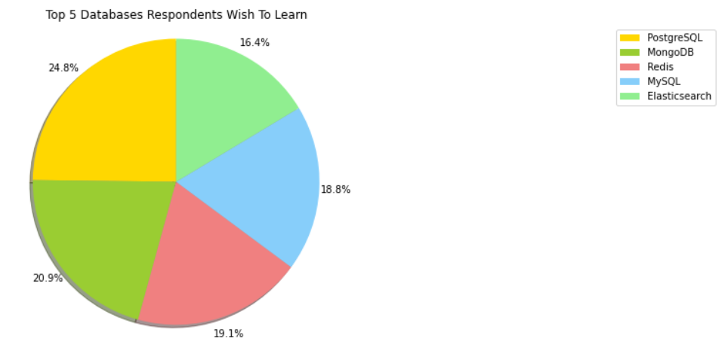
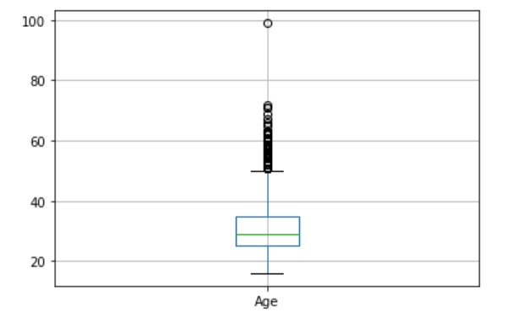
ADDITIONAL VISUALS
The percentage of Respondents for each language expected to learn
Box Plot of Age of Survey Respondents

